Slide 1
CP3405 – Design Thinking & Project Management
Introduction to subject Scrum: the right process

Slide 2
About the Design Thinking Strand
CP1403 – Introduction to Design Thinking
CP2408 – Lean & Agile UX with Design Thinking
CP3405 – Project Management and Implementation

Slide 3
Subject Description
This subject provides students with an advanced conceptual framework to understand the applications of creative technologies in the various disciplines including science and business.
Relevant topics include:
project management for creative IT industries
risk management
time management
project communication
project design and implementation and project deployment
Students will learn basic approaches to creative group problem solving in multidisciplinary teams in the form of two-day "sprint".

Slide 4
Subject Learning Outcomes
evaluate modern tools and technologies to meet project requirements;
apply IT system development and industry standard project development skills;
examine non-traditional modern project management and system development;
apply practical experience in advanced interactive design technologies;
communicate technical information through reports and presentations.
Notes:
Discuss each of these

Slide 5
Subject Structure
Lectures
Weekly 1 hr lecture
Practicals
Weekly Weeks 2-8
Develop your project work with your project team
Teamwork
New project challenge, new project teams
Design Sprint
Sprint participation over two days
1st year 2nd year and 3rd year students form the sprint teams
Notes:
Discuss each of these

Slide 6
Week | Lecture activities | Practical Exercises | Readings | Relationship to assessment
1 | Subject overview The “right and wrong” of software dev | N/A | Subject outline Chap 1,2 | Relevant to the project activities.
2 | Running a pilot study Assessing the pilot study | Group formation Pilot study: select what to pilot | Chap 3,4
3 | SCRUM: Roles (master, owner, dev team) Rituals (sprint planning) Artifacts (story, backlogs, scrum board) | Pilot study: define personas and user stories | Chap 5 Scrum Guides
4 |  | Pilot study: wireframing
5 | SCRUM: Rituals (daily stand-up) Artifacts (done, velocity & burndown charts) | Pilot study: evaluate wireframe SCRUM ritual: sprint planning | Scrum Guides
6 | SCRUM: Rituals (sprint demo) Artifacts (product increment) | SCRUM ritual: daily stand-up
7 | SCRUM: Rituals (sprint retrospective) | SCRUM ritual: sprint demo
8 | Scrum Troubleshooting | SCRUM ritual: sprint retrospective | Extra notes
9 | SCRUM Values | Project help | Scrum Guides
LR
10 | Sprint preparation | Project help |  | Relevant to the design sprint.
11 | IT@JCU Design Sprint
12
13 | Student Project Exhibitions |  |  | Relevant to the final project activities.

Slide 7
Assessment Tasks
Task 1 – Initial project activities 15%
Task 2 – Final project activities 35%
Task 3 – Sprint participation 20%
Task 4 – Practical activities 30%
Notes:
Discuss each of these

Slide 8
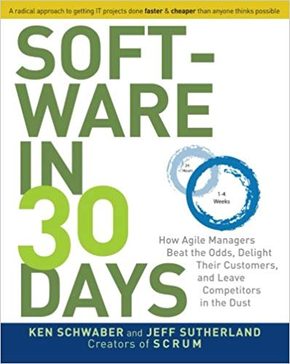
Learning Resources
Lectures and Scrum activities are heavily based on the text
Additional resources:
https://www.scrumguides.org/
https://www.scrumalliance.org/

Slide 9
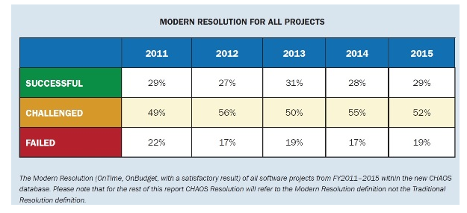
Software projects are OFTEN unsuccessful
Using the definition of success as: delivered on time, within budget with a satisfactory result, only a third of projects are a success

Slide 10
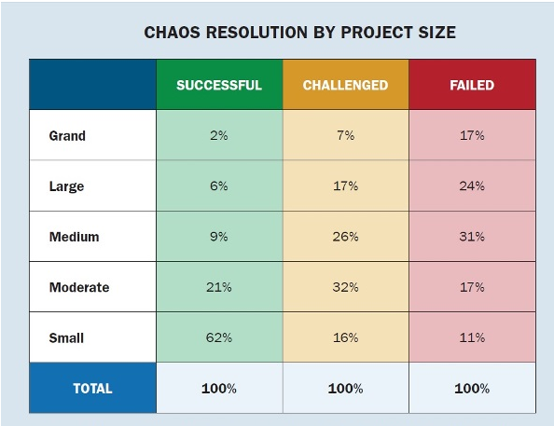
Software projects are OFTEN unsuccessful
Large, complex projects are the most likely to fail

Slide 11
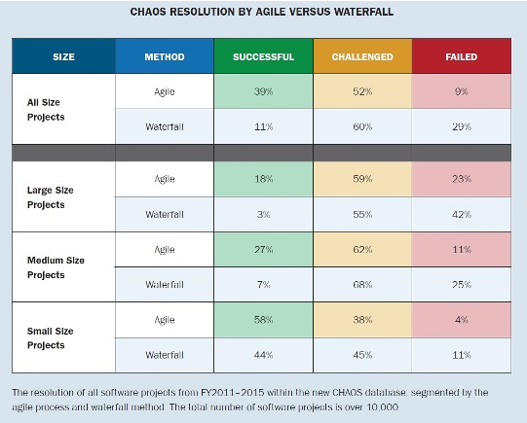
Comparing Agile vs Waterfall success rates
The use of Agile development methods with all sizes of projects leads to higher success rates, primarily due to problems being resolved earlier in the development process
Notes:
Other benefits are greater responsiveness to changing customer requirements, better risk mitigation and better quality software

Slide 12
Case Study – the FBI Sentinel project (fiasco)
Traditional software development process
Targeting 30,000 users (FBI agents, analysts and admin workers)
To be developed in 4 phases
Began in March 2006 and scheduled to be deployed in 2009
By 2010 the project had only delivered the first half of the phases and grossly bogged down in delays and cost-overruns
Stop work order given in 2010 because nearly all the projected funds had been spent and was a year over due
Time to switch to AGILE!
Notes:
Begun in March 2006, goal was to digitise case records of FBI investigations
Targeting an end-user base of more than 30,000 FBI agents, analysts, and administrative employees.
Original estimates for Sentinel were $451 million to develop and deploy by December 2009 to be developed in 4 phases using a traditional software development process (waterfall).
By August 2010, the FBI had spent $405 million of the $451 million Sentinel budget but delivered the functionality for only two of Sentinel's four phases.
Because of the cost and timeline overages, the FBI issued a stop-work order in July 2010 that directed Lockheed Martin to halt all work on the two remaining phases of Sentinel.

Slide 13
Case Study – the FBI Sentinel project
New CIO/CFO decided to try Agile methods, proposed to finish project in 1 year
Reduced staff from 400 to 40, 15 of whom were programmers. The CTO ran the project himself, managing toward a goal of delivering some of Sentinel's functionality every 30 days.
Each increment of functionality had to meet all of the final functional and non-functional requirements—this was no “first draft” software.
Every three months, the FBI would deploy the features that had been built in the preceding three iterations into a field pilot.
By November 2011, within a year of restarting with the new approach, all phases of Sentinel had been completed
The FBI was able to complete Sentinel for $30 million dollars within 12-months, a cost savings of more than 90 percent.
Notes:
By 2009, the FBI recruited a new chief information officer (CIO) and chief technology officer (CTO) with experience managing organizations that built software using our approach. They decided to see if this more agile approach could help the FBI. In 2010, the CTO told the Department of Justice that he was going to change the approach for Sentinel. He asserted that this new approach would streamline decision-making processes and allow the FBI to deliver Sentinel within budget. The FBI told the Inspector General at the Department of Justice that it believed it would be able to complete Sentinel with the remaining Sentinel budget and within 12 months of recommencing. An audit conducted by Mitre had previously concluded that the FBI would need an additional $35 million and six more years if it had continued with its traditional approach.
The FBI moved the entire Sentinel project to the basement of the FBI building in Washington, DC, and reduced the Sentinel staff from 400 to 45 people, 15 of whom were programmers. The CTO ran the project himself, managing toward a goal of delivering some of Sentinel's functionality every 30 days. Each increment of functionality had to meet all of the final functional and nonfunctional requirements—this was no “first draft” software. Every three months, the FBI would deploy the features that had been built in the preceding three iterations into a field pilot.
By November 2011, within a year of restarting with the new approach, all phases of Sentinel had been completed. The software was deployed to a pilot group of FBI locations, and remaining offices are scheduled to see deployment by June, 2012. The FBI was able to complete Sentinel for $30 million dollars within 12-months, a cost savings of more than 90 percent.
The people at the FBI worked hard on the first few phases of Sentinel, but their approach to software held them back. After the FBI shifted its approach to the one we lay out in this book, they worked just as hard as before, but they were rewarded with vastly superior results. If an organization like the FBI can do this, why can't yours?

Slide 14
Australian notable project failures
Myers Online
Queensland Health Payroll System
Australian Cargo Service
Victorian MyKi Card
Notes:
Myers online shopping disaster
Australia’s biggest department store, Myers, invested tens of millions of dollars on website development as it tried to boost online sales. Yet every time the site got busy, it crashed. Stock clearance sales have been plagued by system outages, and on Boxing Day 2013, the whole site imploded. Senior management expressed ‘disappointment’ and apologies to customers. Shareholders were told that such system crashes would not affect profits.
Tens of millions of dollars doesn’t sound like a lack of resources.
Queensland Health and its Payroll System
Queensland Health decided to replace its outdated payroll system, and contracted IBM to design and build a new system. Between 2008 and 2010, IBM submitted multiple change requests because business requirements had not been properly defined.
5 years after commissioning, the system went live with a huge upgrade to costs from the original estimate. And when it did go live, even worse, thousands of workers were underpaid or not paid at all. The total cost to the Queensland taxpayer is estimated at around $1.2 billion.
The Australian Cargo Service
The Australian Customs Service spent around $225 million on upgrading its cargo system. In 2005, it switched over processing, but over the Christmas period cargo was left unprocessed, shipments were delayed, and the system was deemed a complete failure and indicative of poor project governance.
Victorian MyKi Smart Card
The Victorian government has an abysmal record when it comes to IT projects. The most costly is its MyKi Smart Card system, for use on public transport. The project suffered multiple delays and cost overruns. By the time it went live, it was estimated to have cost $1.4 billion.
Undeterred, the Victorian government decided to upgrade and modernize its healthcare IT systems. The Auditor General’s report in 2013 stated that not only had the project cost 50% more than budgeted, but it lacked proper controls which put patients at risk.
In total, such projects have cost Victorian taxpayers around $2 billion.
http://yourprojectmanager.com.au/4-massive-australian-project-failures-failed/

Slide 15
Predictive process of project management (aka “Waterfall”)
The waterfall method requires the assumption that the business case and user requirements will stay the same for the length of the development process
Also assumes that the management team have fully scoped out the project and considered all aspects of program design
Any deviation from the proposed plan offers great risk that it may have cascading effects from small changes

Slide 16
Common problems with waterfall method
Releases take longer and longer
Release schedules slip
Stabilization at end of release takes longer and longer
Planning takes too long and doesn't get it right
Changes are hard to introduce mid-release
Quality deteriorates
Death marches hurt morale
Notes:
See text for details p8-9

Slide 17
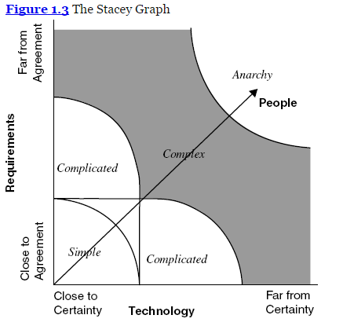
Technology, requirements & people
Notes:
Predictive process works well in factory size implementation where the product does not change, like cars. However, each software project has it's unique requirements and may use different technologies which are often in their infancy. Requiring much up-front planning makes sense for a factory which will then make thousands of products with the same design. However a software development plan is only used once.

Slide 18
Benefits of moving to agile method
Functional specifications can emerge during development
Short development cycles allow for developer/customer collaboration
Developers understand why functionality items are needed and customers are likewise informed of development process
6 month to 1 year larger picture plan, rather than every last detail planned before the start

Slide 19
Empiricism vs prediction
In an empirical process information is gathered through observation rather than prediction
Inspection and adaptation
Transparency
List what tasks we KNOW must be completed
Other development tasks will be added as they become known (backlog of requirements or product backlog)
Notes:
Inspect where we are at so we can adapt our next steps
Transparency means to evaluate our adaptations in terms of meeting our goal

Slide 20
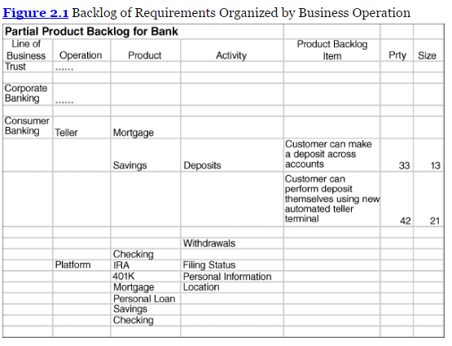
Product Backlog
Notes:
The backlog is an ever changing list of ideas for our software. Items can be added or deleted as needed. Items are prioritised by current importance
Managers meet with the programming teach to pick which items they feel can and should be developed in the next 30 days

Slide 21
Terminology
Iteration A completed set of steps which can be repeated Design -> Develop -> Evaluation
Increment A piece of the completed system that grows over time
Transparency The concept that all increments must be completed in entirety, not leaving pieces unfinished
Iterative incremental Method of developing software through a series of increments

Slide 22
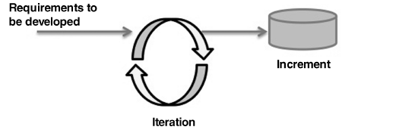
Each iteration produces a completed potentially usable part of the final system
At then end of the iteration we evaluate as to whether the plan needs to be changed to modify that product created

Slide 23
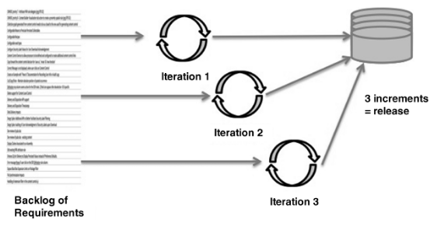
Multiple increments lead to a release
Notes:
Once we have enough increments to merit a release (several) we will do so. This allows us to get feed back from users to help the development cycles.

Slide 24
Does empiricism solve predictive problems?
Waterfall | Agile
Releases take longer and longer | Releases can be made when there are sufficient increments made
Release schedules slip | Max 30 day delay as this is length of iteration. Only work on high value functionality
Stabilisation at end of release takes too long | Each iteration produces a stable increment
Planning takes too long and doesn't get it right | Planning is reduced to what is necessary for 30 day iteration (20% of waterfall)
Changes hard to introduce mid-release | Changes can be made at the end of each iteration, not at end of release
Quality is deteriorating | Each increment is a complete piece of functionality
Death marches are hurting morale | End of release stabilisation is removed, so no need for lengthy overtime and weekend work in order to ship

Slide 25
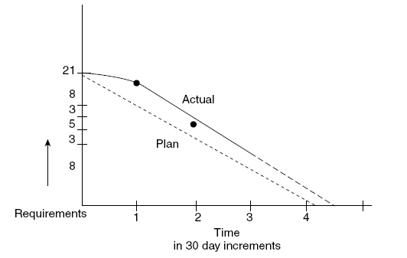
Burndown charts across iterations are useful for tracking development progress
Notes:
Burndown chart for the iteration
Project how many units of work are necessary to complete the work
Estimate how much work can be completed by the team in that period
Time/Requirements give the burndown rate.
Actual performance by the team may be slower than projected due to illness or unfamiliarity with tech or instability of new tech
Performance on this iteration is used to determine if further development of a feature is worth the money (inspection and adaptation)
Empiricism supports management (of requirements), control, predictability and risk mgt

Slide 26
People practices arising from Agile methods Scrum
Respect for the individual worker
Built-in instability – broad challenging goals only from mgt
Self-organising project teams
Cross-fertilisation (share the knowledge)
Overlapping development phases (avoid bottlenecks)
Subtle control – gentle leadership at top using peer pressure
Transfer of learning among team members
Good teams
People manage themselves
Management gets out of the way
Sum of team members is greater than individual skills

Slide 27
Week 1 Summary
Software development is risky business
Empirical rather than predictive methods are best
Scrum as a type of agile method
How agile solves issues with waterfall development

